Slide 1
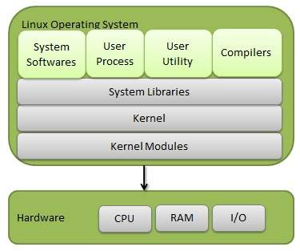
Linux Basics
Linux is full featured, 32-bit multi-user/multi tasking OS
Linux is an open-source operating system. It is like Windows, Mac, Android, etc
It supports communication protocols TCP/IP & Networking
Complete development environment : C/C++/Java/Version controllers etc.
Linux Architecture consists of below layers:
Hardware: The physical devices attached to system such as Hard Disk, RAM, ROM, CPU etc.
Kernel: It is core of Linux and directly interacts with hardware for task execution
Shell: It is user interface and acts as interpreter.. It takes input from user and interacts with Kernel for execution of tasks
Applications: The user applications which runs on shell like Web brower, Media Player and text editor etc

Slide 2
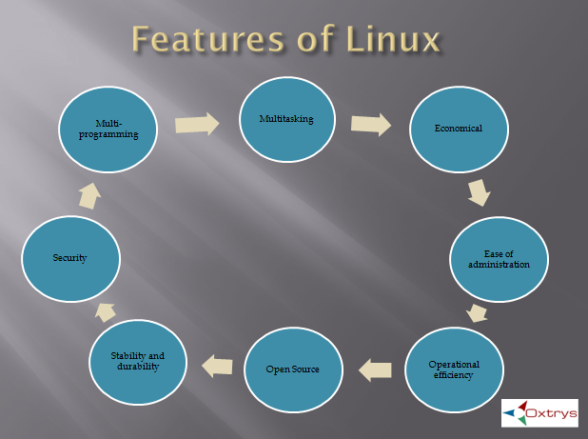
Linux Features
Open Source: Linux source code available for free. No restriction on usage and supports community-based development
Security: One of the top secured OS that makes unique. Provides features like password protection, data encryption, and controlled access to specific file
Stability and durability: The linux servers are more stable and rarely crashes & highly durable runs for years & don’t need periodic reboots
Multi-Programming: Supports running multiple software applications run in parallel
Multitasking: Servers are configured to run multiple tasks run in parallel
Economical: The Linux is open source & its versions are available for low cost
Ease of Administration: Linux servers can be controlled remotely and doesn’t need any software to control

Slide 3
Configuring Linux System
The linux can be configured in Windows PC in multiple ways:
Using “Virtual Box” or Using “vmware”
[Link: https://www.guru99.com/install-linux.html#installing-linux-using-virtual-machine]
Running using Cygwin
[Link: https://geekflare.com/cygwin-installation-guide/]
Using “Docker Container”
Using “Azure”
About 90% of the internet is powered by Linux server, due to Linux is fast, secure, and free
The OS that runs in about 80% of the smartphones in the world, Android, is also made from the Linux kernel
Linux Distributions
Ubuntu Linux
Red Hat
Linux Mint
Debian
Fedora

Slide 4
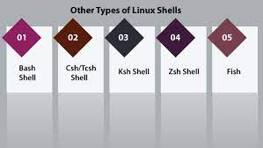
Linux Shell
The Linux shell acts as a “Interpreter” or “Translator” between User and Kernel
A shell is program – that receives the input from user and transfer to Kernel (OS) for execution
Shell uses CLI – Command Line Interface or terminal for executing commands
There are multiple Linux shells
Bash Shell (Default and used most)
Csh/Tcsh
Ksh Shell
Zsh Shell
Fish
There are multiple Linux shells
Print current Shell – echo $SHELL
The prompts used in shells are
$ -- Bash Shell
% -- C Shell

Slide 5
Linux Commands
cmd | Description
pwd | Read present working directory
cd | Change directory.. cd - : switch to previous directory cd ~: go to home directory cd ..: go to previous directory}
ls | List content of directory
cat | Display content of file cat > filename : creates new file cat file1 file2 > file: copy content of file1 and file2 to file cat file: Display content of file
cp | Copy content of one file to other cp file1 file2: Copy content of file1 to file2
mv | Rename file mv file1 file2: Rename file1 to file2
mkdir | Creates new directory mkdir <dir> : creates new directory mkdir –p /home/user/file: create absolute path
cmd | Description
rmdir | Remove the directory * -- Only empty directories can be deleted
rm | Remove directory.. Removes everything
touch | Creates empty file (Used for creating multiple directories at single time) touch f1 f2 f3: Creates f1, f2 and f3 files
locate | Locate file or directories in all paths locate file: Search file in given path
find | Search file in input directory find . –name file.txt –print : search file.txt
sudo | Sudo command used with commands which requires root permissions
df | Display current systems disk usage
du | Display how much space file or directory takes
Head | Display first few lines from file head file: Display first 10 lines from file head –n 5: Display first 5 lines from file

Slide 6
Linux Commands continued …
cmd | Description
tail | Display last 10 lines from file tail: Display last 10 lines from file tail –n 5: Display last 5 lines from file
diff | Display difference of two files Diff file1 file2: Display file1 and file2 differences
tar | Compress or decompress multiple files into single file. Used when sending over network or different server tar -cvf abc.tar /etc /root/dir – copy all files to abc.tar tar -xvf abc.tar – uncompress files and list in current directory
chmod | Change permissions of file or directories chmod 777 file: change file permissions to 777
chown | change owner of file
ping | Ping IP of network to check if it is alive or dead ping <ip address>
top | Display the process information.. Process priority, parent process etc top
cmd | Description
history | Display the history of commands
man | Display
echo | Display variable
zip | zip the files zip example.zip dir/: zip content of dir
unzip | unzip content of .zip file

Slide 7
Linux Commands continued:
grep: (Global Search for Regular Expressions)
Used for searching regular expressions or patterns or strings from file
grep “abcd” file.txt -→ Search & Display line & File matches to pattern “abcd” in file.txt file
grep –c “abcd” file.txt → Search & Display line count of “abcd” in file.txt
grep –h “abcd” file.txt → Search and Display lines but not file name
grep –l “unix” * → Search & Display all files which contains “unix” text
grep –w “unix” file.txt → Search & Display line which matches to whole word
grep –o “unix” file.txt → By default grep display entire line for matched one, but –o indicates to display only matching pattern
grep –n “unix” file.txt → Search & Display pattern along with line
grep –v “unix” file.txt → Search & Display lines which doesn’t match pattern
grep “^unix” file.txt → Search & Display lines which starts with “^unix”
grep “unix$” file.txt → Search & Display lines which ends with “unix”
egrep “unix|linux” file.txt → Display lines which matches to unix or linux
grep –R “unix” directory → Search and display pattern in directory
grep –f file file.txt → Search pattern read from file and display matching line and file

Slide 8
Linux Commands continued:
chmod: (change mode)
There are 3 files mode – read/write/execute and 3 users – user/group/other
Syntax: chmod options permissions file_name
chmod u=rwx, g=rw, o=r → Assign read/write/execute permissions for user, read/write permissions for group and read permissions for other
The permissions also mapped to integer values – 4: read, 2: write, 1:execute, 0: No permission
chmod 754 file → Assign read/write/execute permissions for user, read/execute permission for group and read permission for other
4+2+1 (read, write, and execute), 4+0+1 (read, no write, and execute) & 4+0+0 (read, no write, and no execute)
ls: (List)
ls <options> [file/dir]
ls –a: List info about all files including hidden files in current directory
ls –l: Display inode information of file
ls –s: List files by size
ls –S: list & Sort file by size
ls –t: List files by time

